Slide 1
Predicting Cascading Failures in Power Grids using Machine Learning Algorithms
Rezoan A. Shuvro, Mitun Talukder, Pankaz Das, Majeed M. Hayat
Department of Electrical and Computer Engineering,
Marquette University, Milwaukee, WI, USA

Slide 2

Outline
Overview of Cascading Failures in power grid
Problem, Challenges and Related Works
Data Set and Features
Results
Summary

Slide 3
Cascading Failures in Power Grid : Overview
Loads shifted to nearby elements in the system
Nearby elements are overloaded beyond their capacity
Elements are tripped; load are shifted onto other elements
Cascading chain of failures starts, which can lead to system blackout
A few lines/generators trip initially
Source: Wikipedia

Slide 4
Motivations for this work
Challenges:
Limited amount of real-world data
Generating synthetic cascade data using DC/AC optimal power flow formulations
Validation
Limited amount of prior works
In a recent study by cascading failure working group [1], following critical metrics for cascading failures were identified:
Size and distribution of the blackout size
Amount of Load shedding and Load shed distribution
Critical transmission lines
Related Works: Very few works that use machine learning to predict cascading failures.
Gupta, S., Kambli, R., Wagh, S., & Kazi, F. (2015). Support-vector-machine-based proactive cascade prediction in smart grid using probabilistic framework. IEEE Transactions on Industrial Electronics, 62(4), 2478-2486.
Pi, R., Cai, Y., Li, Y., & Cao, Y. (2018). Machine Learning Based on Bayes Networks to Predict the Cascading Failure Propagation. IEEE Access, 6, 44815-44823.
3. Hink, R. C. B., Beaver, J. M., Buckner, M. A., Morris, T., Adhikari, U., & Pan, S. (2014, August). Machine learning for power system disturbance and cyber-attack discrimination. In 2014 7th international symposium on resilient control systems (ISRCS) (pp. 1-8). IEEE.

Slide 5
Contribution of this work
Development of a cascading failure simulation framework using MATPOWER
Classification of cascading failures in power grids using various machine learning algorithms and their comparison.
Predicting the severity of cascading failures (from amount of lien failures and load shedding) using linear regression technique.

Slide 6
Data set and Features/ Grid Parameters
Features | Feature range/values
Power grid loading level, r | [0.5, 0.5, 0.7, 0.8, 0.9]
Constraint on implementing load-Shedding, θ | [0.05, 0.1, 0.15, 0.20, 0.25]
Uncertainty over the capacity estimation, e (capacity estimation error) | [0.05, 0.1, 0.15, 0.20, 0.25]
Fixed fail probability of neighbors, f_{p} | [0.01, 0.02, 0.03, 0.04, 0.05, 0.06]
avg betwenness rounded ,B | [0, 1.7]
avg SP rounded, S_{p} | [0, 14]
Number of islands, N_{islands} | [1, 54]
flow capacity of the initially failed transmission lines, C_{flow} | [1,1100]
total Number of line fail, N_{p} | [2,114]
Amount of Load-shedding, L_{s} | [0,3352]
Total transmission capacity of the failed lines, C | [40, 13160]
Dataset:
A 76280 X 11 Matrix with 9 features
Output:
Amount of Load-shedding, L_{s}
Total Number of line fail, N_{p}
Source:
MATLAB using MATPOWER [1] m-files.
1. Zimmerman, R. D., Murillo-Sánchez, C. E., & Thomas, R. J. (2011). MATPOWER: Steady-state operations, planning, and analysis tools for power systems research and education. IEEE Transactions on power systems, 26(1), 12-19.

Slide 7
Data collection procedure
Initial power-grid state
(with a defined r, e, θ)
Any islands triggered from failures?
Initial event triggering failures in power grid
Solve the power flow optimization problem for each island
Yes
Remove failed lines
Solve power flow optimization problem
No
Power lines overloaded?
No
Finish
Remove the overloaded lines from the system
Flowchart represents cascading failure simulation framework
Yes

Slide 8
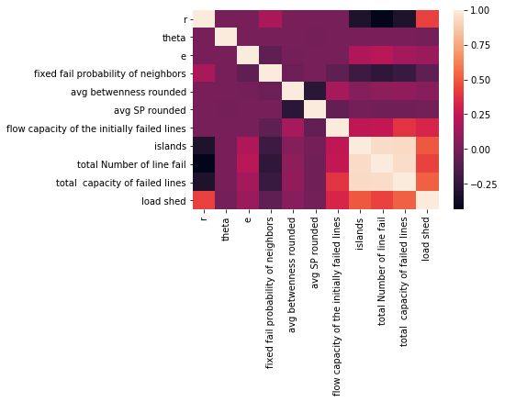
Correlation between Features
Correlation plot shows:
High correlation between total number of failed lines and total capacity of the failed lines.
Strong correlation between amount of load shed and loading level, total number of failed lines and total capacity of failed lines
Topological features (average shortest path and average betweenness ) have very low correlation with the outputs(total number of failed lines, amount of load shed)

Slide 9
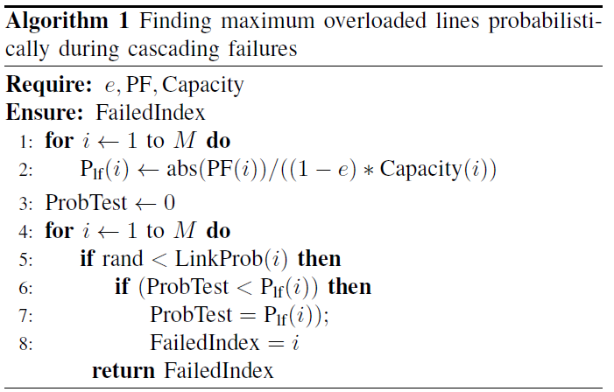
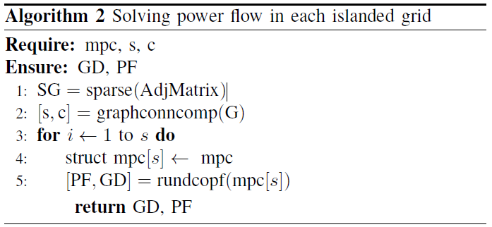
Algorithms for cascading failure simulation
Algorithms used to find the maximum overloaded line in one iteration and solving power flow in each island.

Slide 10
ML Algorithms used and Metric for evaluation
We use the following algorithms for classification:
Logistic regression
KNN (k nearest neighbor)
Random forest
Decision tree
Support vector machine
Adaboost
Linear regression (for prediction)
Classification Metric:
Precession - recall - f1-score
Regression metric:
- mean absolute error - mean square error - root mean square error

Slide 11
Predicting Cascading failures
Total Number of transmission lines =186
Initial condition: 2 line failures
No cascade = Less than 10 failures
small cascade = greater than 10 and Less than 25 failures
Large cascade = greater than 25 failures
Random forest and SVM gives best accuracy

Slide 12
Predicting Cascading failures
Random forest and SVM gives best accuracy

Slide 13
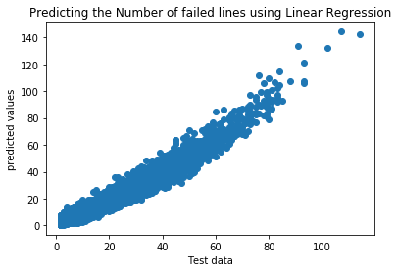
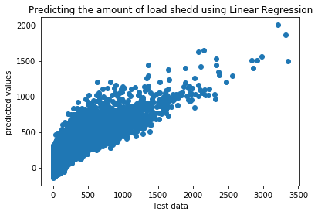
Linear regression to predict the number of failed lines and the amount of Load shedding
Metrics | Error
Mean Absolute Error | 1.90
Mean Square Error | 7.07
Root Mean Square Error | 2.66
Metrics | Error
Mean Absolute Error | 82.92
Mean Square Error | 15334.84
Root Mean Square Error | 123.83
Linear regression works well for predicting the number of lines
To minimize error for load shed prediction, nonlinear regressor such us SVR, RFR can be used

Slide 14
- Machine learning algorithms were used to predict cascading failures in power grids. - Results suggest that all the algorithms gives higher prediction accuracy( Random forest and Support vector Machines are the best with 0.91 precision) - We predicted the number of failed transmission lines with low error using linear regression - We predicted the amount of Load shed using linear regression, but the error was high. - We didn’t observe strong correlation between cascading failures and topological features which is consistent with [1] - Future works includes finding the distribution of transmission line failures and amount of load shedding as well as improvement on the accuracies
Summary
Korkali, M., Veneman, J. G., Tivnan, B. F., Bagrow, J. P., & Hines, P. D. (2017). Reducing cascading failure risk by increasing infrastructure network interdependence. Scientific reports, 7, 44499.

Slide 15


Thank you for your time
Questions?

Slide 16


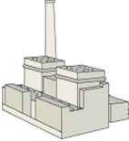

Overview of complex Power grid Infrastructure
Control operators
Human,
computer
Initial event
Natural, human error, WMD
Cascading failures
Wireless
3/4G, WiMAX, LTE
Wired
IP, optical
Communication
Network
Power-grid loading level, r
Load-shedding constraint level, θ
Line-capacity estimation error, e
Power grid operating parameters
Generation
(power plants)
Power Grid
Infrastructure
Power
substation
Distribution
Transmission
Distribution

Slide 17
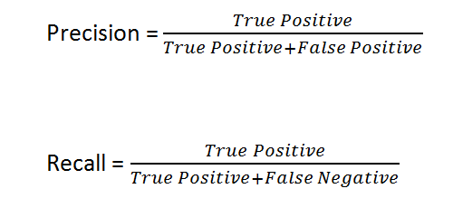

Annex1:

